Slide 1
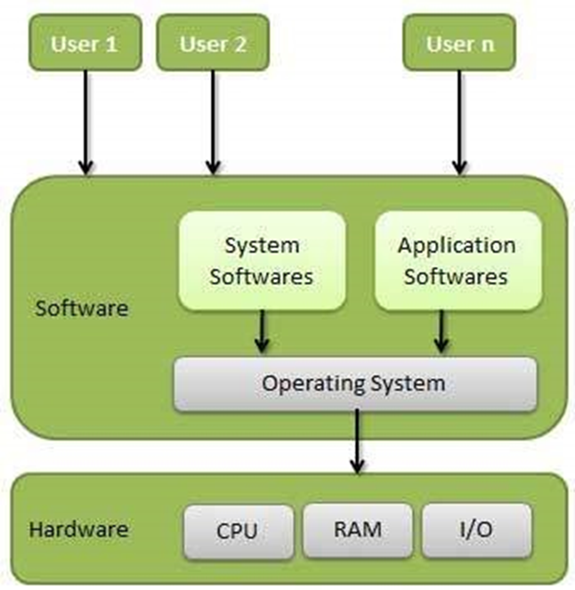
Operating System
An operating system, or "OS," is software that communicates with the hardware and allows other application of the computer to run.
Single- and multi-tasking
Single- and multi-user
Distributed
Embedded
Real-time
Library

Slide 2
Windows Operating System
Microsoft Windows is a group of several graphical operating system families, all of which are developed, marketed, and sold by Microsoft.
Comparison | MAC | Windows | Linux
SECURITY | No Virus | Many types Virus | Less Virus
PRICE | Too expensive | Less than MAC | Open Source free software
COMPATIBILITY | Only with MAC | All type of software | We can program the software that how we want
RELIABLE | Reliable & smooth | Reliable & Strucks | Not completely

Slide 3
Advantage & Disadvantage of Windows OS
ADVANTAGES | DISADVANTAGES
1. Ease of use | High resource requirements
2. Backwards compatibility | Closed Source
3. Support for new hardware | Poor security & Poor support for older hardware
4. Better Stability | Extortionist prices
5. It supports secure boot | Poor remote access
6. It allows many programs to operate at the same time | Backwards incompatible file formats

Slide 4
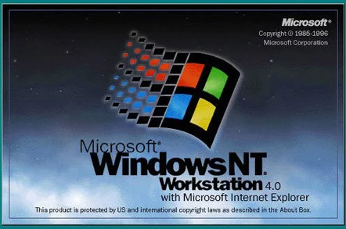
Workstation
A significant segment of the desktop market are computers expected to perform as workstations, but using PC operating systems and components.
Support for ECC memory
Larger number of memory sockets which use registered (buffered) modules
Multiple processor sockets, powerful CPUs
Multiple displays
Run reliable operating system with advanced features
High performance, reliable graphics card

Slide 5
Windows workstation and Server
Windows Workstation Platform support for the PowerPC Improved PCMCIA support Common controls and dialogs 16 bit Delrina WinFax support NTFS per File and per Directory Compression Customizable WinLogon Sequence Integrated NetWare connectivity | Windows Server New Server Manager Expanded PowerShell Capabilities Expanded cluster scalability

Slide 6
Windows client and server

Slide 7
Features of Windows 7 and Server 2008 R2

Slide 8
Features of Windows 8 and Server 2012 R2

